Slide 1
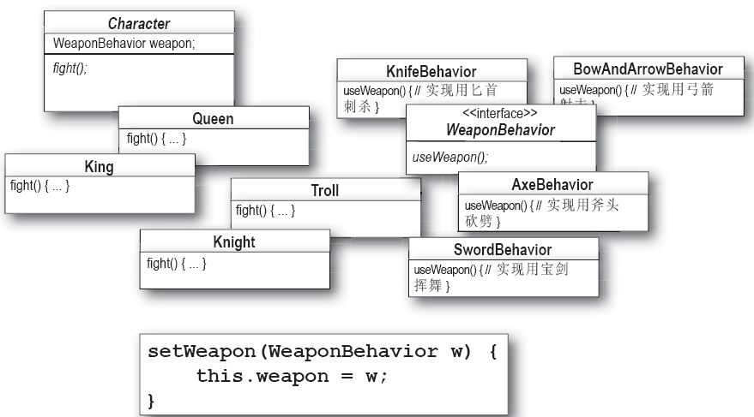
实验内容1：要求

Slide 2
实验内容1参考设计方案

Slide 3
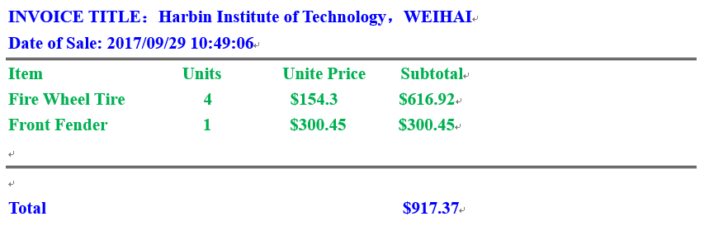
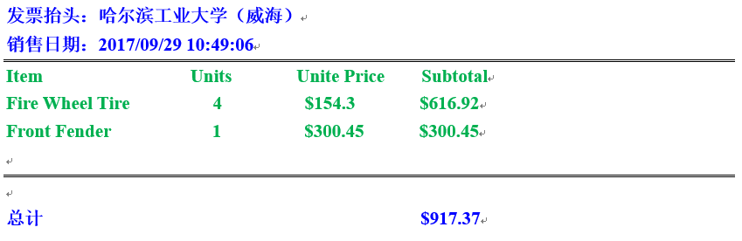
实验内容2：要求

Slide 4
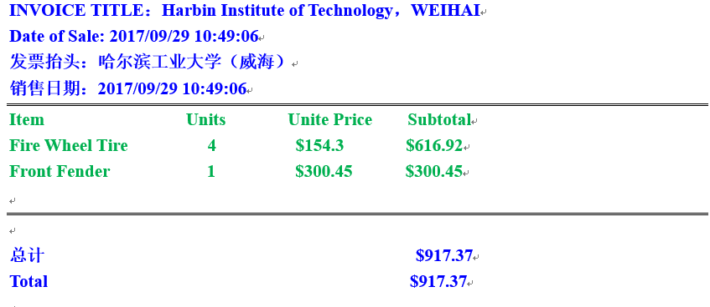
实验内容2：要求

Slide 5
实验内容2：发票头尾的理解
INVOICE TITLE：XYZ Incorporated
Date of Sale: Sun May 26 21:42:36 EDT 2019
===================================================
Item Units Unite Price Subtotal
Fire Wheel Tire 4 $154.3 $616.92
Front Fender 1 $300.45 $300.45
===================================================
Total $917.37
Header
Body
Footer

Slide 6
实验内容2：类图

Slide 7
实验内容2：代码实现
public abstract class Invoice {
private String customerName;
private String shoppingDate;
private ArrayList invoiceLines = new ArrayList();
public double getTotal() {// 累加方式计算总价
…
}
public void addInvoiceLine(InvoiceLine il) {
…
}
public void removeInvoiceLine(InvoiceLine il) {
…
}
public abstract void performPrint();
//setters and getters
}
Notes:
在超类中，与咖啡冲泡机案例不同点在于：除了performprint抽象方法之外，还需要对属性值的设定
继承层次也比之前案例多了一层
调试发现，内层的值传递不到外层，因此需要进一步处理

Slide 8
实验内容2：代码实现
public abstract class InvoiceDecorator extends Invoice {
private Invoice invoice;
public InvoiceDecorator(Invoice invoice) {
super();
this.invoice = invoice;
this.setInvoice(invoice);
this.setCustomerName(invoice.getCustomerName());
this.setShoppingDate(invoice.getShoppingDate());
this.setInvoiceLines(invoice.getInvoiceLines());
}
//setter and getter
}

